Slide 3

TITLE 2
Insert pic
Insert company logo
Name | Title | Date

Slide 5


Meeting Overview
ATTENDEES:
Client:
Name, title
Name, title
CareCloud:
Name, title
Name, title
AGENDA:
Topic 1
Topic 2
© CareCloud, Inc. 2023

Slide 8


Slide 9
Text
© CareCloud, Inc. 2023

Slide 10
Corporate Slides
© CareCloud, Inc. 2023

Slide 11
CARECLOUD OVERVIEW

Slide 12






Industry Leaders
Industry leading software platforms across clinical, financial and patient
experience​
at-a-Glance​
Initial Public Offering
CareCloud was founded in
2000, IPO in 2014​
NASDAQ: CCLD
CareCloud provides technology-enabled revenue cycle management and a full suite of cloud-based solutions that help clients increase financial and operational performance, streamline clinical workflows and improve the patient experience.
Our portfolio includes revenue cycle management (RCM), practice management (PM), electronic health records (EHR), patient experience management (PXM), ​business intelligence, digital health, as well as premier HIT consulting and on-demand staffing.
3,800 Employees
3,800 global employees with more than 400 research and development and information technology staff members​
40,000 Providers
Approx. 40,000 providers leverage our products and services in 80 medical
specialties​
2,600 Medical
Practices
Serving more than 2,600 large & small medical practices, hospitals and health systems in all 50 states
$6 Billion
Powering healthcare transactions at scale including $6 billion in insurance claims & patients' receivables​
11

Slide 13









Our Growth History
Jun. 2021
Acquired
MedMatica Consulting Associates, Inc. &
Santa Rosa Staffing &
expanded
solutions to hospitals
Jul. 2014
Initial public offering and three acquisitions
Jan. 2020
Acquired
CareCloud Corporation
& expanded our EHR capabilities
Oct. 2016
Acquired MediGain, LLC
Jul. 2018
Acquired
Orion Healthcorp, Inc.
Nov. 2014-
Jul. 2016
Acquired seven different RCM companies
Jul. 2017
Acquired Washington Medical Billing, LLC
Apr. 2019
Acquired Etransmedia Technology, Inc.
Jun. 2020
Acquired Meridian Billing Management Co. and added world-class
BI and RPA solutions
12

Slide 14

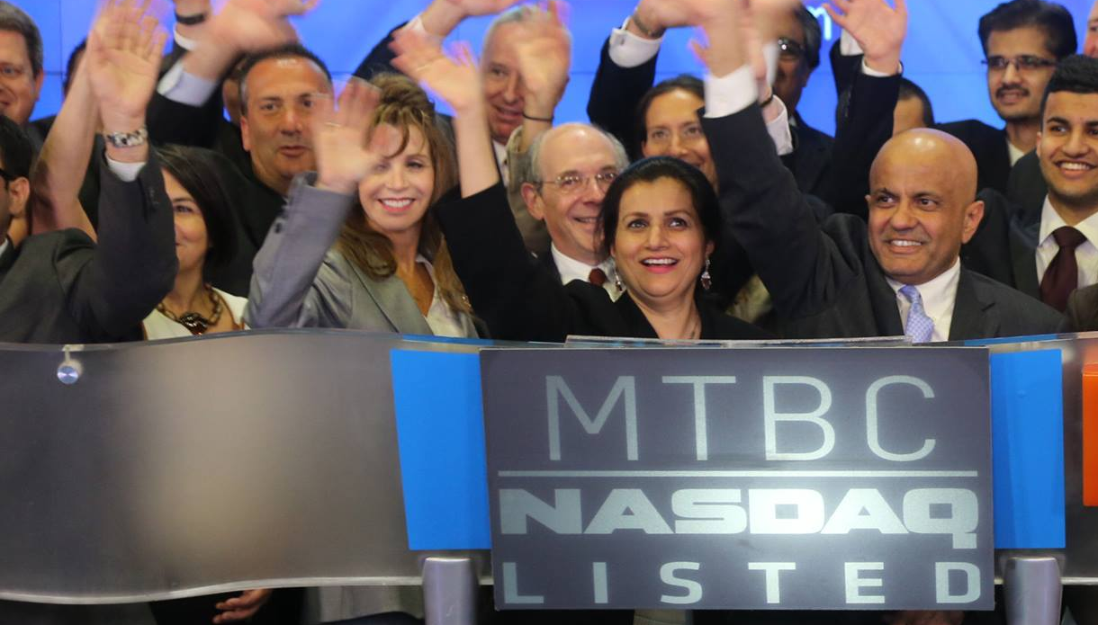

I created CareCloud as an answer to what seemed to be a formidable problem at the time. It was built from the ground up using tenacity and resilience, and it is through these virtues that CareCloud continues to thrive. The CareCloud team was and continues to be uniquely positioned to excel in the most challenging environments.
Mahmud Haq
Founder, CareCloud

Slide 15

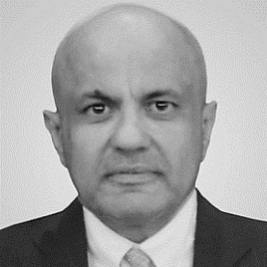
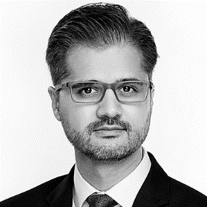

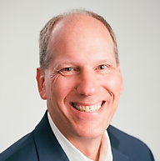
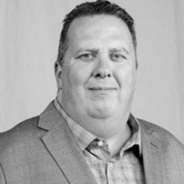
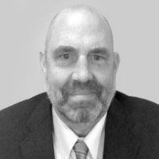

Proven Leadership Team
Mahmud Haq
Founder &
Executive Chairman
A. Hadi Chaudhry
President, Chief Executive
Officer & Director
Bill Korn
Chief Strategy Officer
Larry Steenvoorden
Chief Financial Officer
  Former CEO of Compass International Services (Nasdaq: CMPS); completed 14 acquisitions in 18 months, grew revenue to ~$180M run-rate, and acquired by NCO Group
  Increasing senior positions at American Express
  B.S., Aviation Management, Bridgewater State College
  M.B.A., Finance, Clark University
  Joined in 2002
  Previously served as Manager of IT, General Manager, Chief Information Officer, and VP of Global Operations
  Extensive healthcare IT experience, including various roles in the banking and IT sector
  B.S., Mathematics & Statistics; numerous IT certifications
  Joined in 2013
  Former CFO of Antenna Software (2002-2012); completed 5 acquisitions, driving 87% CAGR
  Former executive at IBM (NYSE: IBM) for 10 years
  A.B., Economics, magna cum laude, Harvard College
  M.B.A., Harvard Business School
  Accomplished financial executive with more than 30 years of experience in healthcare, life science, and med-tech sectors
  15 years of experience at Siemens AG with M&A and external reporting
  B.S., Accounting, University of Delaware
  M.B.A., Finance, Rider University
Steve Link
Chief Operating Officer
Karl Johnson
President, CareCloud Force​
Dwight Garvin
Executive Vice President & Chief Operating Officer, medSR​​
  30 years of experience in the healthcare and financial services industries, including 8.5 years at athenahealth​
  B.A., Business Administration, New England College of Business
  Black Belt Certification, Six Sigma Qualtec
  More than 30 years of experience in hospital administration & physician management​
  Founded a large physician management company in 1997 which was acquired by CareCloud in 2016
  B.S., Healthcare Administration, Brigham Young University
  M.B.A., Healthcare Administration, Brigham Young University
  More than 30 years of experience in healthcare technology, including tenures at athenahealth, Cerner and Deloitte Consulting​​
  B.S., Medical Technology & Clinical Laboratory Science, Auburn University
  M.B.A., Business Administration, University of Alabama, Manderson Graduate School of Business
© CareCloud, Inc. 2023

Slide 16



Global Workforce and Presence
3,800
Global
Employees
~3,400
Offshore
NJ HQ
13
U.S. Office Locations
~400
Onshore
3
International
Office Locations

Slide 17













Enabling a Broad Spectrum of Clients and Partners
Software, Apps & Tools
Technology-enabled Business Solutions
Healthcare Business Services
Small Medical Practices​
CareCloud leverages a global workforce to ensure costs are kept low and every medical practice can afford necessary technology
Large Physician Groups
CareCloud provides comprehensive packages or customized options to fit into complex systems already adopted by the group
Hospitals & Health Systems​
CareCloud's systems are built for interoperability, allowing easy communication of information between platforms
Industry ​Partners
CareCloud's strengths allow us to turn smaller competitors into customers - or industry partners - by supporting their back-end needs

Slide 18






Healthcare Provider Pain Points
Patient Experience​
Physician Burnout​
Transition to Value-Based Care​
Reimbursement Challenges​
Administrative Burden​
Staffing​
Higher demand for better experience & tech due to patient burden​
Doctors working harder and getting paid less​
Transition requires ​
risk-taking, different model for care delivery​
Increased coding complexity​
Physicians spending more time entering data, less time with patients​
​
Staffing shortages ​
and labor inflation
CareCloud’s Value Proposition
Enhances the patient​
experience with ‘digital front-door’ tools like check-in, eligibility, and pre-authorization​
Digitizes and automates physician workflows​
​
Provides analytics to help stratify risk, report on utilization trends, and measure outcomes​
Improves compliance and reduces regulatory complexity
Improves cash collections and removes billing and scheduling burden from providers
Alleviates staffing shortages ​with short- and long-term workforce augmentation​
​

Slide 19
SOLUTION PORTFOLIO

Slide 20
Our Mission
REDEFINE
the next generation of solutions
technology-enabled RCM
healthcare

Slide 21







Generative AI
EMPOWERING EVERY CLINIC. ELEVATING PATIENT CARE.
Evidence-based care plans
Real-time medical queries to improve care response
New clinician onboarding
Front-end cost estimations for clinic and patient
  CareCloud and Google Cloud are partnering to bring generative AI to CareCloud solutions.
  The collaboration allows small and medium-sized practices, which frequently have limited resources, to harness the advantages of generative AI.
  The first CareCloud solution using generative AI is expected to launch in the coming months.
© CareCloud, Inc. 2023

Slide 22





CareCloud’s Robust End-to-End Solutions
Redefining the next generation of
technology-enabled revenue cycle solutions
TECHNOLOGY-ENABLED RCM
CLOUD-BASED SOFTWARE
DIGITAL HEALTH
HIT CONSULTING & STAFFING
ADDITIONAL PROVIDER SERVICES
Revenue Cycle Management
Medical Coding
Provider Credentialing
Robotic Process Automation
Interoperability
Electronic Health Records
Practice Management
Patient Experience Management
Business Intelligence
Customized Cloud Applications
Chronic Care Management
Remote Patient Monitoring
Telemedicine Solutions
Workforce Augmentation
IT Transformation Consulting
Strategic Advisory Services
Hospital RCM Optimization
Activation as a Service
Home Healthcare
Release of Information
Group Purchasing Organization
Professional Services
Print Fulfillment

Slide 23

CareCloud’s Robust End-to-End Solutions
Redefining the next generation of
technology-enabled revenue cycle solutions
TECHNOLOGY-ENABLED RCM
CLOUD-BASED SOFTWARE
DIGITAL HEALTH
HIT CONSULTING & STAFFING
ADDITIONAL PROVIDER SERVICES
Revenue Cycle Management
Medical Coding
Provider Credentialing
Robotic Process Automation
Interoperability
Electronic Health Records
Practice Management
Patient Experience Management
Business Intelligence
Customized Cloud Applications
Chronic Care Management
Remote Patient Monitoring
Telemedicine Solutions
Workforce Augmentation
IT Transformation Consulting
Strategic Advisory Services
Hospital RCM Optimization
Activation as a Service
Home Healthcare
Release of Information
Group Purchasing Organization
Professional Services
Print Fulfillment

Slide 24
CareCloud’s Robust End-to-End Solutions
Redefining the next generation of
technology-enabled revenue cycle solutions
TECHNOLOGY-ENABLED RCM
CLOUD-BASED SOFTWARE
DIGITAL HEALTH
HIT CONSULTING & STAFFING
ADDITIONAL PROVIDER SERVICES
Revenue Cycle Management
Medical Coding
Provider Credentialing
Robotic Process Automation
Interoperability
Electronic Health Records
Practice Management
Patient Experience Management
Business Intelligence
Customized Cloud Applications
Chronic Care Management
Remote Patient Monitoring
Telemedicine Solutions
Workforce Augmentation
IT Transformation Consulting
Strategic Advisory Services
Hospital RCM Optimization
Activation as a Service
Home Healthcare
Release of Information
Group Purchasing Organization
Professional Services
Print Fulfillment

Slide 25

CareCloud’s Robust End-to-End Solutions
Redefining the next generation of
technology-enabled revenue cycle solutions
TECHNOLOGY-ENABLED RCM
CLOUD-BASED SOFTWARE
DIGITAL HEALTH
HIT CONSULTING & STAFFING
ADDITIONAL PROVIDER SERVICES
Revenue Cycle Management
Medical Coding
Provider Credentialing
Robotic Process Automation
Interoperability
Electronic Health Records
Practice Management
Patient Experience Management
Business Intelligence
Customized Cloud Applications
Chronic Care Management
Remote Patient Monitoring
Telemedicine Solutions
Workforce Augmentation
IT Transformation Consulting
Strategic Advisory Services
Hospital RCM Optimization
Activation as a Service
Home Healthcare
Release of Information
Group Purchasing Organization
Professional Services
Print Fulfillment
© CareCloud, Inc. 2023

Slide 26
CareCloud’s Robust End-to-End Solutions
Redefining the next generation of
technology-enabled revenue cycle solutions
TECHNOLOGY-ENABLED RCM
CLOUD-BASED SOFTWARE
DIGITAL HEALTH
HIT CONSULTING & STAFFING
ADDITIONAL PROVIDER SERVICES
Revenue Cycle Management
Medical Coding
Provider Credentialing
Robotic Process Automation
Interoperability
Electronic Health Records
Practice Management
Patient Experience Management
Business Intelligence
Customized Cloud Applications
Chronic Care Management
Remote Patient Monitoring
Telemedicine Solutions
Workforce Augmentation
IT Transformation Consulting
Strategic Advisory Services
Hospital RCM Optimization
Activation as a Service
Home Healthcare
Release of Information
Group Purchasing Organization
Professional Services
Print Fulfillment
© CareCloud, Inc. 2023

Slide 27









Technology-Enabled RCM
As a leading provider of end-to-end revenue cycle solutions, we excel at delivering comprehensive and customized solutions to improve practice profitability.
Options:
1
2
3
CareCloud Concierge RCM
Comprehensive bundle includes 4 essential solutions:
CareCloud RCM
Platform-agnostic RCM services include:
Custom RCM
Customized solutions to fit any need, such as:
RCM
CareCloud Concierge
EHR
CareCloud Charts or talkEHR
RCM
CareCloud Concierge
Workforce Augmentation
CareCloud Force
RCM
CareCloud Concierge
Existing
Platform
PM
CareCloud Central
PXM
CareCloud Breeze
Hospital RCM Optimization
medSR
Specialty Specific Solutions

Slide 28






Technology-Enabled RCM (cont.)
Revenue Cycle Management
Credentialing
We assist in credentialing healthcare providers with Government/Commercial Payers/Managed Care Plans and obtain CAQH quarterly re-attestations.
Contract/Payer Negotiations
We’ll review existing payer/plan contracts, make appropriate recommendations for fee schedule/reimbursement terms, and track progress through the negotiation process.
Benefits Verification
We provide full phone, fax, and email support to outline patient benefits and coverage for specific medical procedures, before the point of service.
Prior Authorization
We provide full phone, fax, and email support to obtain the prior approval necessary to acquire reimbursement for most non-emergency medical procedures.
Inbound Patient Call Center
Patients can use our call hotline to talk to our dedicated team about any billing inquiries they may have. We can also collect payment over the phone for additional support.
Out of Network Billing
We handle everything from sending claims and posting payments to negotiating the payment from the payer and working with the payer to pay the negotiated amount.

Slide 29











Technology-Enabled RCM (cont.)
Microbots
Microbots are “Digital Workers” that use Microservices & APIs enabling simple handshakes between disparate EHR, PM and Enterprise systems to automate repetitive, manual tasks.
Robotic Process Automation
Platform Agnostic Applications
Claim Status
Eligibility Denial
Medical Record Attachments
Authorization Confirmation
Contract Payment Alerts
Self-Pay Eligibility
Payment Posting
Timely Filing Alerts
Auto Adjustments
Health & Wellness Checks

Slide 30


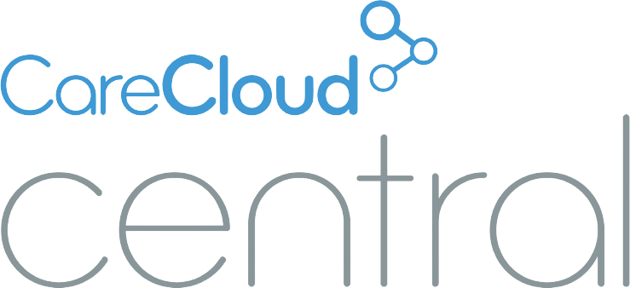





Cloud-Based Software
Robust solutions for mid to enterprise level providers
Integrated solutions for growing, nimble practices
EHR
EHR+PM
Practice Management
Patient Experience Management
Business Intelligence
lite
Telemedicine

Slide 31



Digital Health
A transformational suite of digital health solutions
Chronic Care Management
Remote Patient Monitoring
Improving patient satisfaction by proactively managing multiple chronic conditions outside the clinical setting.
Enabling proactive patient engagement by monitoring real-time health data with connected devices.

Slide 32
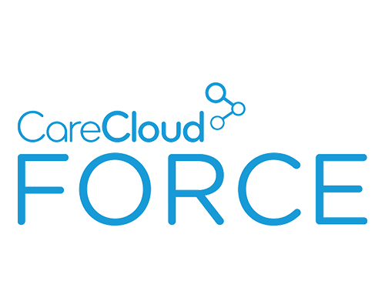



HC IT Consulting & Staffing
Fractional RCM
Aged A/R Rundown
Data Entry
Form Processing
Tech Support
Workforce Augmentation
Help Desk
Team Efficiency
A dedicated team of professionals serve as an extension of your own staff to enhance service quality and productivity for administrative and back-office support functions.
Scalable Growth
Rapid 30-day transition, driven by our experienced team and flexible platform technology capabilities, to support growth by scaling your workforce efficiently to achieve the next level of your business.
Software & Custom Development
Leverage our robust EHR, PM, and Telehealth software available for white-label purposes or utilize our dynamic IT developers to deliver overall support and enhancements to your applications.

Slide 33


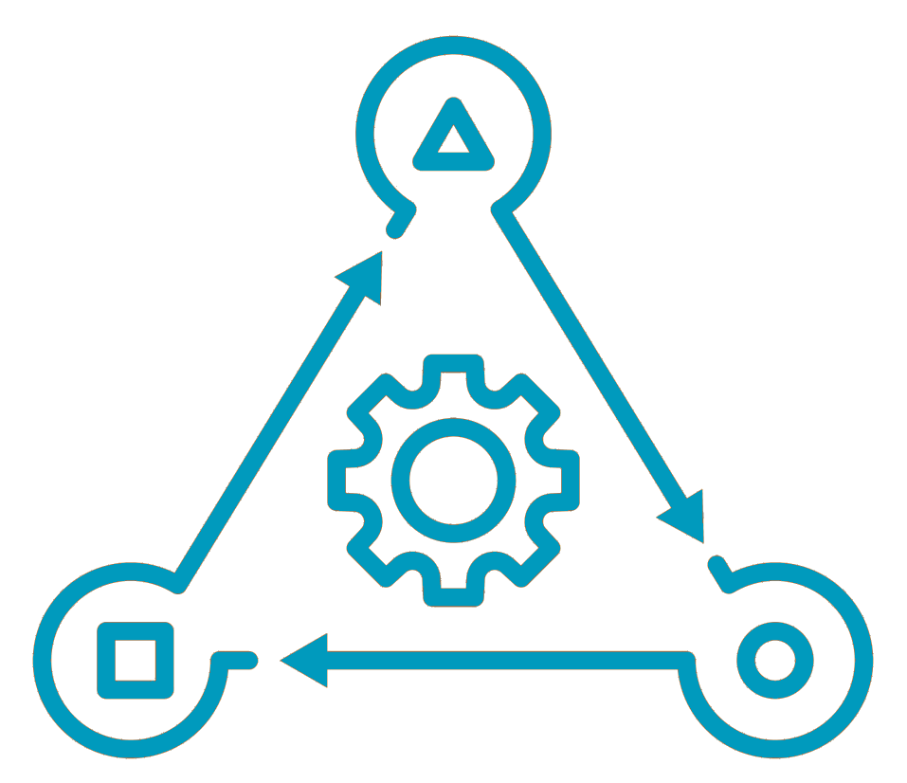


HC IT Consulting & Staffing (cont.)
Healthcare IT Consulting
Hospital RCM Optimization
IT Transformation Consulting
medSR provides premier healthcare IT and operations consulting to help clients navigate the increasing pressures of the healthcare industry with a full lifecycle of services.
From IT system selection and end-user training to revenue cycle optimization, each service line is led by advocates with decades of experience in RCM and the latest EHR solutions.
Our management team and professional consultants offer extensive MEDITECH and operational experience to exceed client expectations in a cost-effective manner. We have worked with many clients in a variety of settings and are dedicated to the collaboration it takes to work together to drive healthcare organization's success.
Strategic Advisory Services
Activation as a Service

Slide 34


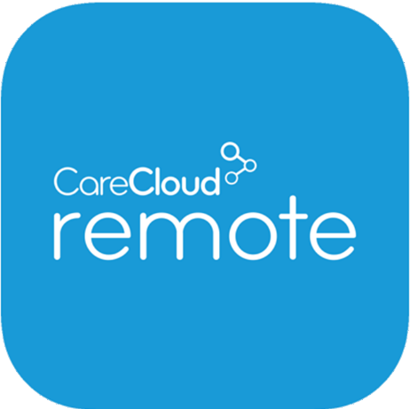




Additional Provider Services
Home Healthcare
Group Purchasing Organization
Additional Services
Professional Services
World-class professional services and innovative tools to help realize the full value of your new solutions.
Savings Categories
Release of Information
CareCloud Archivus is a platform that simplifies ROI workflow to ensure the secure, accurate, and timely fulfillment of requests.
Surgical & Office Supplies
Vaccinations
Helping established home healthcare facilities manage operations, streamline patient scheduling, and get ahead on referrals.
Communications & Technology
Compliance
& Audit

Slide 35



Group Purchasing Organization
Savings Categories
Surgical & Office Supplies,
Branding & Apparel
Save up to 20% on supplies, branded materials, apparel & scrubs
Online ordering
Premium vendors
Vaccinations
Save up to 20% off vaccination expenses
Additional discounts offered for online orders and prompt pay
Communications
& Technology
Up to 50% off on Communications hardware / VOIP equipment
Easy order through e-store discounts
Compliance
20% off on recurring compliance expenses
Audit assistance and response services
Collections
Reduced fees on patient balance collections through third party vendors for patient balances and self-pay A/R
Partnerships

Slide 36


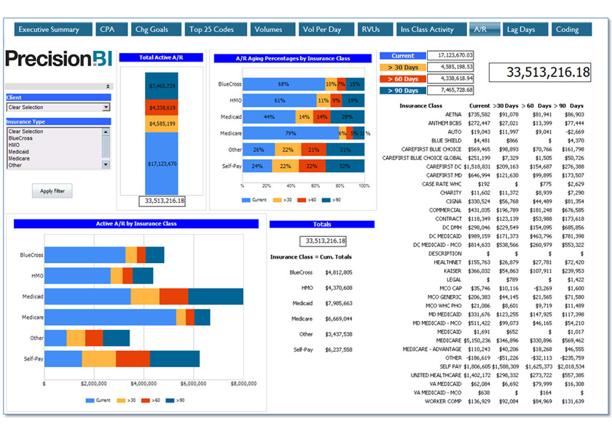
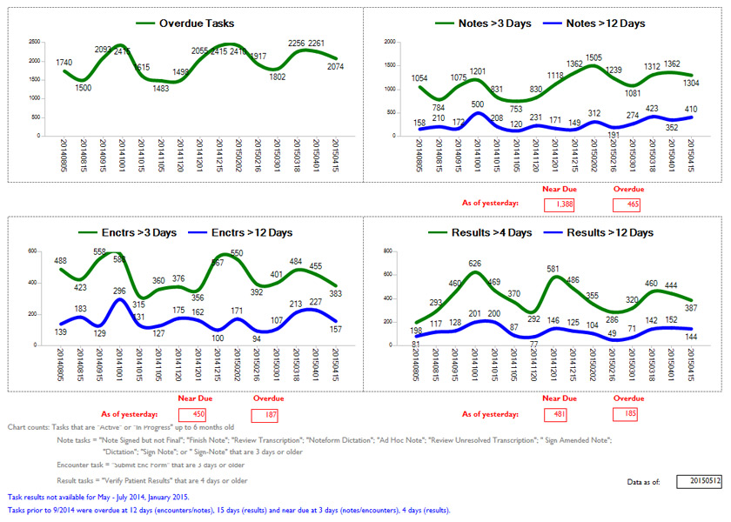
Business Intelligence

Slide 37
ADDITIONAL

Slide 38




CareCloud’s Unique Strengths Provide a Competitive Advantage
The combination of CareCloud’s leading healthcare technology platform, low-cost global team, and proven track record of integrating acquired businesses and turning them profitable gives CareCloud a competitive advantage.
Technology Platform
Streamlines workflow
Increases revenue
Decreases expenses for customers
Global Team
Unparalleled cost structure
Globally distributed workforce
Proven Market Consolidator
Repeatable M&A framework
Rapid integration methodology
Highly fragmented market opportunity

Slide 39






The CareCloud Difference
19M
Unique patient records
40,000
Medical professionals leveraging our solutions
3,800
Global delivery
team members
20+
Years of experience
50
U.S. states
80+
Clinical specialties
19M
Unique patient records
6B
Annualized collections

Slide 40


Case Study: Rocky Mountain Internal Medicine (RMIM)
One of the Largest in the Denver Area
Preventive, Acute & Chronic Healthcare
D.O.T. Examinations, Stress Test, Sleep Studies, Sigmoidoscopy, Radiology, Women Health, PFT, Audiometry
4
Clinics
Product expansion through proven performance
CareCloud’s RPM has made a big impact for our patients by removing the barriers to physically access care, which allows us to monitor their information daily without them having to come into the clinic.
– RMIM
2021
2022
2018
2020
RCM
Services
talkEHR
+
Patient Experience Management
Telehealth Services
CareCloud Wellness
CCM+RPM

Slide 41




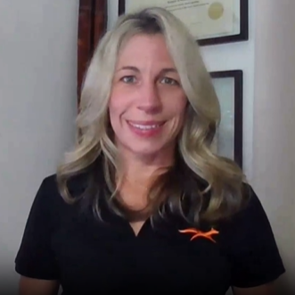
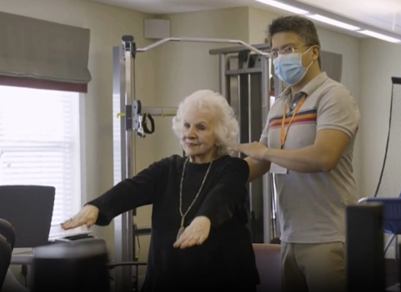
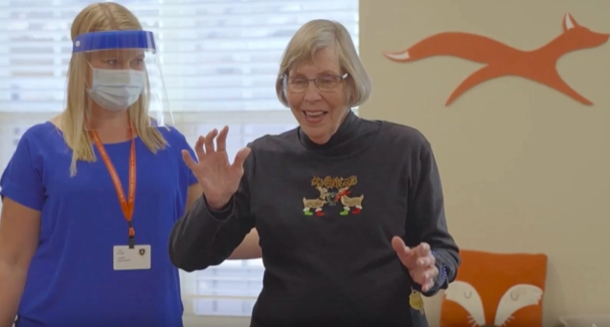
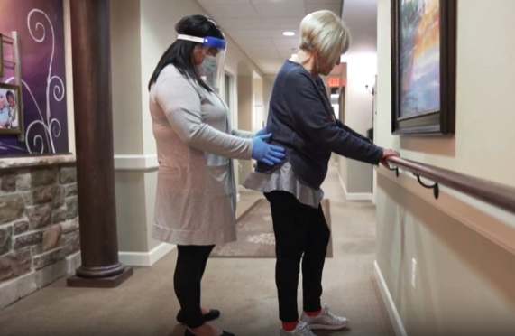
Partnership: FOX Rehabilitation
27
States
2,800
Providers
5+
Therapies
World’s largest private practice of independent clinicians delivering therapy care to older adults.
Created unique mobile application to geo-connect patients with therapists, reducing referral to admission by days
Reduced denials from 8% to under 3%
Reduced and maintained Aged AR to 27 days (goal was 35 days)
Carey Sambogna
Vice President of Client Services
FOX Rehabilitation Services

Slide 42





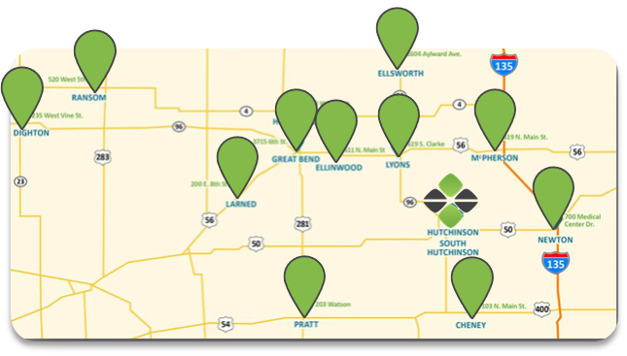
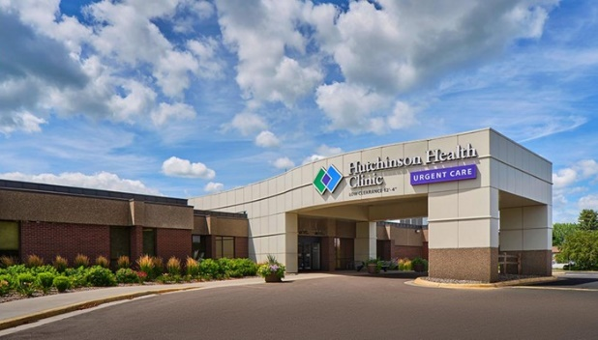
Partnership: The Hutchinson Clinic
100+
Providers
550+
Employees
500K+
Patient Encounters
1.2M
Lab Tests
Revenue Cycle Management coverage included coding of all claims, physician education, patient posting; +implemented Business Intelligence
Reduced days in AR by 13%
Reduced Aged AR by 9%
Dashun Monk
Chief Financial Officer
The Hutchinson Clinic

Slide 43


Thank You!
carecloud.com
Name
Title
Email address
Phone W
Mobile M
7 Clyde Road | Somerset, NJ 08873
42
© CareCloud, Inc. 2023

Slide 44


Thank You
carecloud.com
Name
Title
Email address
Phone W
Mobile M
7 Clyde Road | Somerset, NJ 08873
43
© CareCloud, Inc. 2023

Slide 45


Questions
© CareCloud, Inc. 2023

