Slide 1
TITLE 1
TITLE 2

Slide 2

TITLE 1
Insert pic
Insert company logo
Name | Title | Date

Slide 4

Meeting Overview
ATTENDEES:
Client:
Name, title
Name, title
CareCloud:
Name, title
Name, title
AGENDA:
Topic 1
Topic 2
© CareCloud, Inc. 2026

Slide 6


Slide 7
Text

Slide 8
CARECLOUD OVERVIEW

Slide 9






Industry Leaders
Industry leading software platforms across clinical, financial and patient
experience​
at-a-Glance​
Initial Public Offering
CareCloud was founded in
2000, IPO in 2014​
NASDAQ: CCLD
CareCloud delivers technology-enabled revenue cycle management (RCM) and a full suite of cloud-based healthcare solutions designed to enhance financial and operational performance, streamline clinical workflows, and elevate the patient experience.
Our comprehensive portfolio includes Revenue Cycle Management (RCM), Practice Management (PM), Electronic Health Records (EHR), Patient Experience Management (PXM), Business Intelligence, Digital Health Solutions and Premier HIT Consulting & On-Demand Staffing.
3,800 Employees
3,800 global employees with more than 400 research and development and information technology staff members​
40,000 Providers
Approx. 40,000 providers leverage our products and services in 80 medical specialties​
2,600 Medical
Practices
Serving more than 2,600 large & small medical practices, hospitals and health systems in all 50 states
$6 Billion
Processing over $6 billion in insurance claims and patient receivables annually.
8

Slide 10


at-a-Glance​
CareCloud empowers healthcare organizations of all sizes with next-generation, AI-powered services and solutions that improve clinical, financial, and administrative outcomes.
3,800 Global
Employees
40,000 Providers
2,600 Medical Practices
80+ Medical
Specialties
2000 – Founded
2014 – Nasdaq: CCLD
9
Notes:
STOCK PUBLIC - CareCloud was founded in 2000, IPO in 2014​
$6B - Powering healthcare transactions at scale including $6 billion in insurance claims & patients' receivables​
4,000 global employees - with more than 500 research and development and information technology staff members​.
NO 3rd Party Outsourcing!
Serving more than 2,600 large & small medical practices, hospitals and health systems in all 50 states

Slide 11










Our Growth History
Jul. 2014
Initial public offering and three acquisitions
Oct. 2016
Acquired MediGain, LLC
Jul. 2018
Acquired
Orion Healthcorp, Inc.
Jun. 2021
Acquired MedMatica
Consulting Associates,
Inc. & Santa Rosa Staffing (medSR), expanding solutions to hospitals
Sept. 2025
Acquired Medsphere Healthcare IT Solutions
Jan. 2020
Acquired
CareCloud Corporation
& expanded our EHR capabilities
Nov. 2014-
Jul. 2016
Acquired seven different RCM companies
Jul. 2017
Acquired Washington Medical Billing, LLC
Apr. 2019
Acquired Etransmedia Technology, Inc.
Oct. 2025
Acquired HFMA's MAP App
Jan. 2020
Acquired Meridian Billing Management Co. and added world-class BI and RPA solutions
Apr. 2025
Hearing Aid Practice Operations and RCM
10
Notes:
Expand the offering with carecloud -

Slide 12

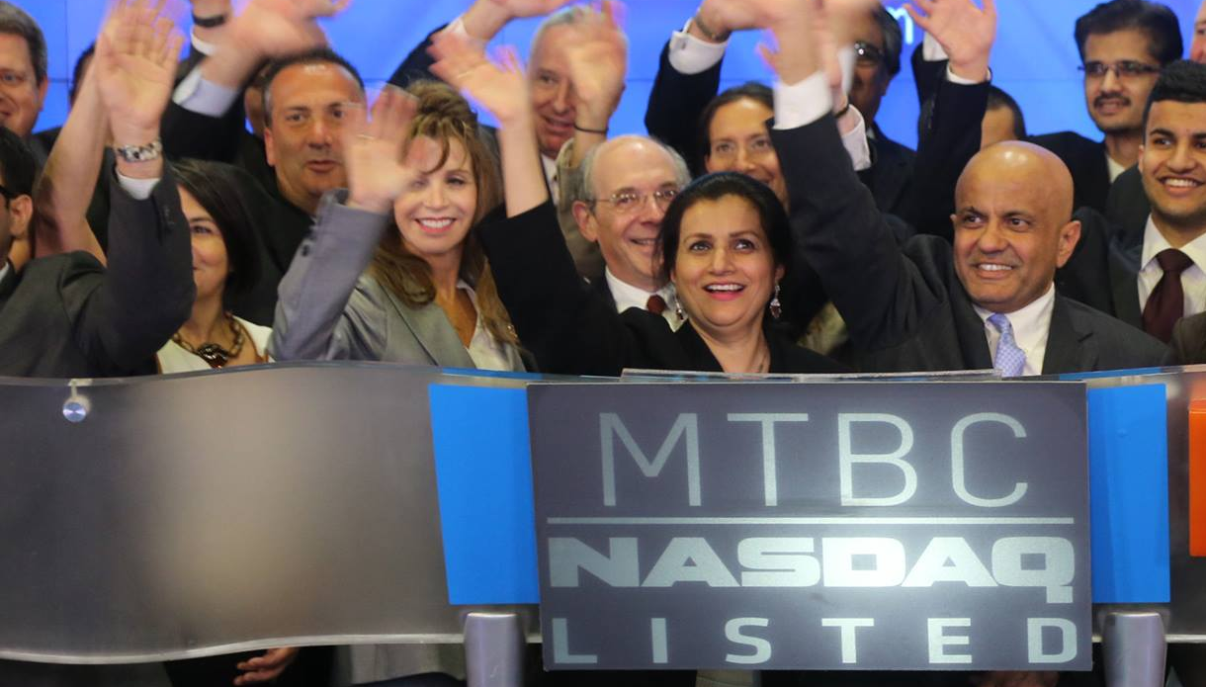

I created CareCloud as an answer to what seemed to be a formidable problem at the time. It was built from the ground up using tenacity and resilience, and it is through these virtues that CareCloud continues to thrive. The CareCloud team was and continues to be uniquely positioned to excel in the most challenging environments.
Mahmud Haq
Founder, CareCloud

Slide 13

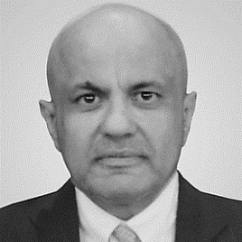
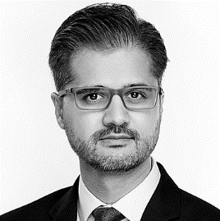
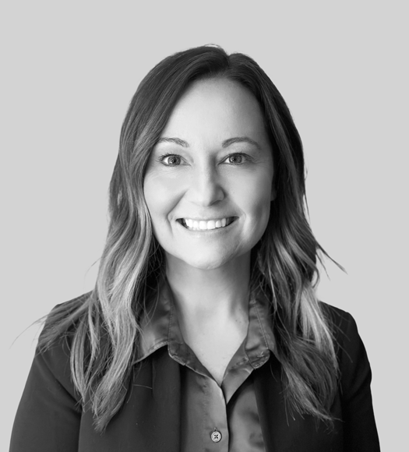
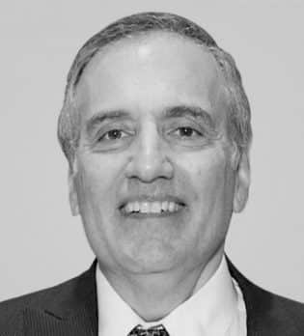
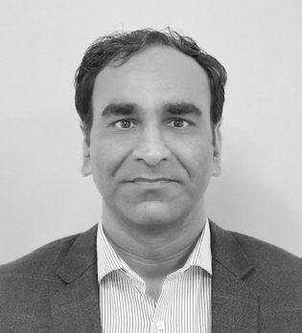
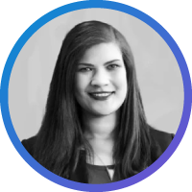
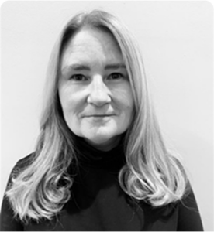

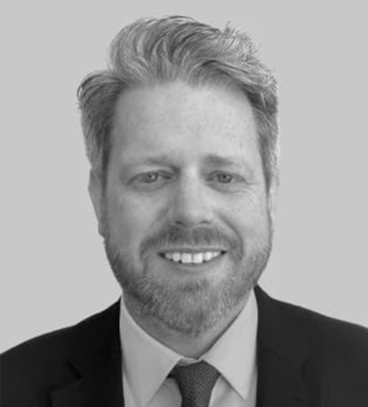
Leadership Team
Mahmud Haq
Founder &
Executive Chairman
A. Hadi Chaudhry
Co-Chief Executive Officer
Stephen Snyder
Co-Chief Executive Officer
Crystal Williams
President
Former CEO of Compass International Services (Nasdaq: CMPS); completed 14 acquisitions in 18 months, grew revenue to ~$180M run-rate, and acquired by NCO Group
Increasing senior positions at American Express
B.S., Aviation Management, Bridgewater State College
M.B.A., Finance, Clark University
Joined in 2002
Previously served as Manager of IT, General Manager, Chief Information Officer, and VP of Global Operations
Extensive healthcare IT experience, including various roles in the banking and IT sector
B.S., Mathematics & Statistics; numerous IT certifications
Joined CareCloud in 2005 as General Counsel; held key roles including COO, Chief Strategy Officer, and President
Deep expertise in healthcare IT, mergers & acquisitions, and regulatory strategy
Instrumental in advancing transformative healthcare technology and driving company growth
J.D., Rutgers University School of Law; licensed to practice in NJ and NY
Brings 20+ years of leadership in Revenue Cycle Management (RCM) and global healthcare operations
Oversees Client Success, Credentialing, and Coding with a focus on operational excellence
Former Chief Operating Officer; led initiatives to enhance client satisfaction and revenue optimization
Deep expertise in regulatory compliance, payer data analytics, and tech-enabled healthcare solutions
Norman Roth
CFO and Corporate Controller
Adeel Sarwar
Chief Technology Officer
Kristen Rothe
Corporate Counsel | Compliance & Privacy Officer
Loraine Goetsch
Division President and Senior Vice President of Integrations
Brings 40+ years of financial leadership, specializing in corporate finance, reporting, and compliance
Joined CareCloud in 2014; leads initiatives to enhance financial performance and accountability
Former forensic accountant focused on accounting malpractice (2003–2014)
Certified Public Accountant (CPA) and Certified Fraud Examiner
Joined CareCloud (formerly MTBC) in 2004; instrumental in the company’s technological growth
Leads strategy, development, and implementation of tech solutions for clients, partners, and internal teams
Deep expertise in building advanced healthcare technology products that drive innovation and business value
Known for aligning IT strategy with business goals to fuel operational efficiency and revenue growth
Has specialized experience in litigation, intellectual property, and business law representing corporations and local governments
Leads company-wide compliance with privacy laws and industry regulations
Key contributor to contract negotiations, risk management, and data governance strategies that support organizational growth
Brings 20+ years of leadership experience at CareCloud, joining the company in 1999
Has held pivotal roles including VP of Operations, Revenue Cycle Management, and Sales
Leads integration strategies that drive efficiency, innovation, and scalable growth
Key contributor to CareCloud’s continued expansion and operational excellence

Slide 14
Boards of Director
Mahmud Haq
Founder &
Executive Chairman
A. Hadi Chaudhry
Co-Chief Executive Officer
Bill Korn
Chief Strategy Officer
Anne M. Busquet
Board Director
Former CEO of Compass International Services (Nasdaq: CMPS); completed 14 acquisitions in 18 months, grew revenue to ~$180M run-rate, and acquired by NCO Group
Increasing senior positions at American Express
B.S, Aviation Management, Bridgewater State College
M.B.A., Finance, Clark University
Joined in 2002
Previously served as Manager of IT, General Manager, Chief Information Officer, and VP of Global Operations
Extensive healthcare IT experience, including various roles in the banking and IT sector
B.S., Mathematics & Statistics; numerous IT certifications
Chief Strategy Officer at CareCloud with 87% Compound Annual Growth Rate across six CFO roles.
Harvard MBA graduate serving on Nasdaq-listed company board.
CareCloud Board Director since 2014 with 30+ years executive leadership at American Express and Interactive Corp (IAC)
President of AMB Advisors serving on multiple boards including Pitney Bowes and Columbia Business School, with Cornell/Columbia education.
John N. Daly
Board Director
Cameron P. Munter
Board Director
Lawrence Sharnak
Board Director
50+ years financial services expertise as Executive VP and Board Director at E.F. Hutton, plus division leadership at Salomon Brothers (NY/London).
Yale graduate with Harvard Business School Advanced Management Program, currently Trustee Emeritus at Culinary Institute of America.
Former U.S. Ambassador to Pakistan, Serbia, and Iraq serving on CareCloud's Board since 2013.
Cornell magna cum laude graduate with Johns Hopkins PhD and former President of EastWest Institute, currently senior advisor to Berlin-based Agora Strategy Group.
30+ years at American Express in senior leadership roles, founding sponsor of key employee diversity networks and workplace culture initiatives.
CareCloud Board member since 2020 with University of Massachusetts BBA and Babson MBA, serving on multiple advisory boards including Cinch Board Services.

Slide 15

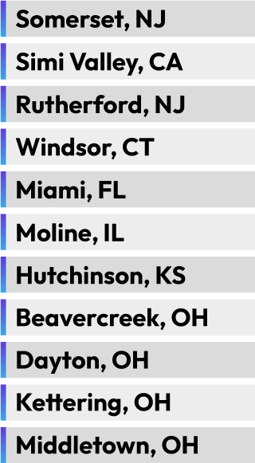


Global Workforce and Presence
3,800
Global
Employees
~400
Onshore
~3,400
Offshore
NJ HQ
11
U.S. Office Locations
3
International
Office Locations

Slide 16


















Customer Profiles
Small Medical Practices​
Large Physician Groups
Health Systems​
Medical Billing Companies

Slide 17



Customer Profiles
Small Medical Practices​
Large Physician Groups
Health Systems​
Medical Billing Companies
Transform your small practice with cloud-based, AI-powered solutions that increase profitability and operational independence. CareCloud helps streamline workflows, reduce overhead costs, and improve overall efficiency.
Electronic Health Records
Practice Management
Remote Patient Monitoring
Integrated patient portal for secure patient engagement.
Customizable templates and order sets for efficient documentation.
Real-time clinical decision support to enhance care quality.
Streamlined appointment scheduling and patient flow management.
Integrated billing and claims processing to reduce administrative tasks.
Comprehensive reporting tools for performance monitoring.
Provision of devices with durable batteries and international SIM cards at no cost.
Secure transmission of patient data to extend care beyond the clinic.
Enhanced patient engagement through continuous monitoring.
Notes:
Small: CareCloud leverages a global workforce to ensure costs are kept low and every medical practice can afford necessary technology

Slide 18



Customer Profiles
Small Medical Practices​
Large Physician Groups
Health Systems​
Medical Billing Companies
Scale effortlessly with advanced, cloud-based technologies and world-class services tailored for large and expanding medical groups.
Healthcare Interoperability
Revenue Cycle Management
Patient Engagement & Experience
Smooth data exchange between EHRs, payers, and health networks.
Powered by CareCloud Connector for secure, real-time data sharing.
Enhances care team collaboration and data accessibility.
Automated billing tasks, including claim submission and verification.
Reduces administrative burdens and increases efficiency.
Improves cash flow through streamlined processes.
Secure messaging and digital tools to keep patients connected.
Features include digital check-ins, appointment reminders, and outreach.
Enhances patient satisfaction and health outcomes.
Notes:
Large: CareCloud provides comprehensive packages or customized options to fit into complex systems already adopted by the group. This includes Co-sourcing to employ team members on site

Slide 19



Customer Profiles
Small Medical Practices​
Large Physician Groups
Health Systems​
Medical Billing Companies
From integrated software platforms to strategic consulting, CareCloud empowers health systems to streamline operations, enhance care coordination, and improve outcomes across the full continuum of care.
Healthcare IT Consulting
Workforce Augmentation
Additional Solutions
Expert guidance for EHR implementation and system optimization.
Aligns technology with clinical workflows.
Supports strategic initiatives and boosts operational performance.
Provides skilled professionals to supplement internal teams.
Reduces hiring costs and bridges talent gaps.
Grants access to specialized expertise beyond local limitations.
CareCloud Integration Hub: Enables real-time system connectivity across departments.
Population Health Management: Tracks and manages patient outcomes at scale.
Notes:
Large: CareCloud provides comprehensive packages or customized options to fit into complex systems already adopted by the group. This includes Co-sourcing to employ team members on site

Slide 20
Customer Profiles
Small Medical Practices​
Large Physician Groups
Health Systems​
Medical Billing Companies
CareCloud offers flexible RCM software and services designed to empower medical billing companies, enabling better control over business operations and client satisfaction.
Increased Revenue
Patient Care
Reporting and Analytics
Optimized AI-Integrated billing workflows to enhance efficiency.
Reduced claim denials through accurate coding and submission.
Enhanced financial health for clients with streamlined processes.
CareCloud handles billing, allowing practices to focus on patient care.
Free up resources to prioritize exceptional patient experiences.
Transparent, detailed reporting for financial performance insights.
Gain insights into financial performance and trends.
Notes:
Large: CareCloud provides comprehensive packages or customized options to fit into complex systems already adopted by the group. This includes Co-sourcing to employ team members on site

Slide 21
SOLUTION PORTFOLIO

Slide 22






End-to-End Revenue Cycle Management
Patient appoinment
Insurance Eligibility Varification
Claim entry
Claims Validation, Scrubbing
Claim Submission
Payment Posting
Rejecting, Denials Handling
Patient Statements
Aging Analysis
Report/ Auditing
Initial Patient Encounter
Performed by Practice
Registration and scheduling
Eligibility and pre-certification
Prior authorizations & verifications of benefits
Coding
Credentialing
Clean Claims Submission
Review charge entry
Integrity check
Claim scrubbing
Proactive corrections
Claim submission
Analytics and Consulting
A/R and management reporting
Collections turn-over and coordination
Develop efficient workflow
Advise on Best Practices
Claims Management
Rejection correction
Claim correction and resubmitting
Payment posting
EOB Reconciliation
Verification of Deposits
A/R Management
Denial management and tracking
Appeals and follow-up
Appeal escalation - Attorney lead team
Patient Statements - additional fees apply to paper only
Patient inquiry calls (toll free number)
Implement an aged balance workflow
Compliance Services
Credentialing audits
Fraud and abuse claim prevention
Monitoring for patient privacy
Value Based Care review and audit prevention
Government and commercial rules monitoring

Slide 23


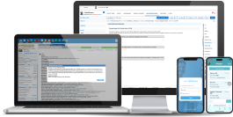
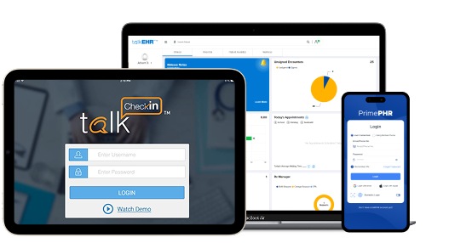

EHRs, PMs, and Patient Engagement Platforms
Available as a White Label Solution

Slide 24


Credentialing
Multiple Outreach Attempts
Full Credentialing & Enrollment (Average time 60-90 days)
Revalidations
Re-credentialing
Additional Credentialing Services:
Practice Start-Ups
Physician Credentialing / Insurance Enrollment Services
NP & PA Credentialing
Annual Credentialing Maintenance
State Licensure
State & National DEA Certification
Medicare Enrollment Services
ASC, Laboratory, & Mobile Services Credentialing
Hospital Privileging
Screening &
Data Entry
Primary Source
Verification
PREPARATION
Receive Provider
Data From Client
Populate and
Send Application
Application
Credentialing
Process
Quality
Review
Release
To Client
Set Next
Credentialing Date
Archive Final Verifications
Report

Slide 25




Medical Coding
Accessing Patient Charts
Hospital coding for 70+ specialties, such as:
Inpatient services
Ambulatory outpatient clinics
Emergency departments and emergency medicine physicians
Diagnostic radiology departments
Interventional radiology services
ASC and same day surgery programs
Cardiac catheterization laboratories
GI endoscopy services
Surgical pathology
Employed physicians
Temporary coding services for vacation and sick leave
Backlog coding resolutions services
Coding compliance audits
Coding education
Submission of
Copied Charts
Pre-Coding
Quality Audit
CPT & ICD-10
Coding

Slide 26










Technology-Enabled RCM
As a leading provider of end-to-end revenue cycle solutions, we excel at delivering comprehensive and customized solutions to improve practice profitability.
Options:
1
2
3
CareCloud Concierge RCM
Comprehensive bundle includes 4 essential solutions:
CareCloud RCM
Platform-agnostic RCM services include:
Custom RCM
Customized solutions to fit any need, such as:
RCM
CareCloud Concierge
EHR
CareCloud Charts
or talkEHR
RCM
CareCloud Concierge
Workforce
Augmentation
CareCloud Force
RCM
CareCloud Concierge
Existing
Platform
PM
CareCloud Central
PXM
CareCloud Breeze
Hospital RCM Optimization
medSR
Specialty Specific Solutions

Slide 27




CareCloud’s End-to-End Solutions
CareCloud is your AI-driven health tech partner with end-to-end services.
AI-POWERED REVENUE CYCLE MANAGEMENT (RCM)
AI-ENHANCED SOFTWARE
DIGITAL HEALTH
HIT CONSULTING & STAFFING
ADDITIONAL PROVIDER SERVICES
Revenue Cycle Management
Medical Coding
Provider Credentialing
AI-Driven Workflow Automation
Interoperability
Electronic Health Records
Practice Management
Patient Experience Management
Business Intelligence
cirrusAI Notes
Chronic Care Management
Remote Patient Monitoring
Telemedicine Solutions
Workforce Augmentation
IT Transformation Consulting
Strategic Advisory Services
Hospital RCM Optimization
Activation-as-a-Service
Home Healthcare
Release of Information
Group Purchasing Organization
Professional Services
Print Fulfillment
Notes:
RCM services – coding – RCM only – services on their platfor we have X amount of platform we provided – FUll end to end solution – CareCloud platform -
Software:
Services: RCM
Options: Size dependant Coding and E.N.T - Suzanne to provide a slide...

Slide 28
CareCloud: your AI-driven health tech partner
Delivering end-to-end healthcare and revenue cycle solutions powered by AI.
AI-POWERED REVENUE CYCLE MANAGEMENT (RCM)
AI-ENHANCED SOFTWARE
DIGITAL HEALTH
HIT CONSULTING & STAFFING
ADDITIONAL PROVIDER SERVICES
Revenue Cycle Management
Medical Coding
Provider Credentialing
AI-Driven Workflow Automation
Interoperability
Electronic Health Records
Practice Management
Patient Experience Management
Business Intelligence
cirrusAI Notes
Chronic Care Management
Remote Patient Monitoring
Telemedicine Solutions
Workforce Augmentation
IT Transformation Consulting
Strategic Advisory Services
Hospital RCM Optimization
Activation-as-a-Service
Home Healthcare
Release of Information
Group Purchasing Organization
Professional Services
Print Fulfillment

Slide 29





Your Partner in Healthcare Solutions
cirrusAI Assist
cirrusAI Voice
cirrusAI brings practical, secure generative AI to everyday healthcare workflows. Inside the EHR and PM, it drafts cleaner notes, suggests accurate codes, answers in-chart FAQs, and surfaces next-best actions reducing clicks and delays across clinical, financial, and operational work. Teams gain time back through AI-assisted documentation, coding, claim prep, and patient messaging, while configurable guardrails and role-based controls keep humans in the loop. cirrusAI is designed to support HIPAA compliance, respects data governance, and integrates with existing CareCloud solutions to accelerate adoption without disrupting your day. The result: fewer manual tasks, clearer decisions at the point of care, faster revenue cycles, and a better experience for staff and patients alike.
cirrusAI Notes
AI Desk Agent

Slide 30

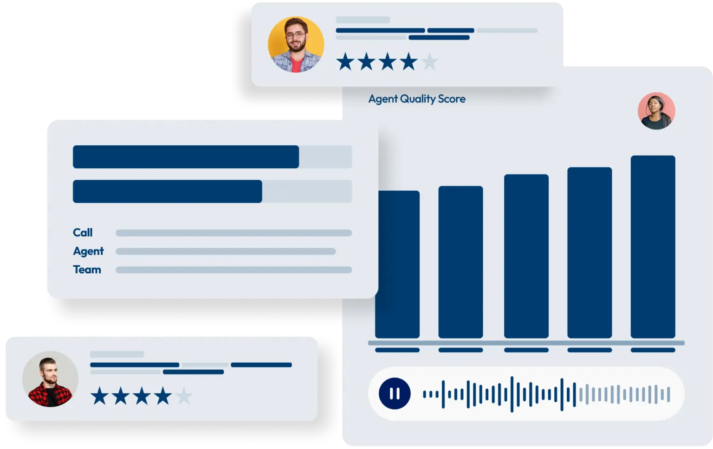
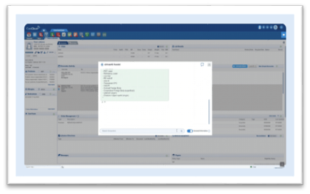
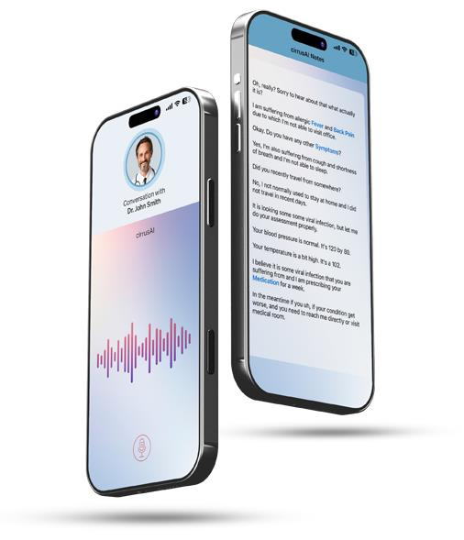
cirrusAI Assist
cirrusAI Notes
cirrusAI Voice
Advanced call auditing powered by AI
Automatic call analysis for every interaction
Real-time scoring to assess call quality on the fly
AI-generated summaries to capture key points and next steps
Interactive dashboards for trends, outliers, and drill-downs
AI-powered virtual assistant that streamlines clinical and administrative workflows
Answers medical queries in-chart for clinicians and staff
Automates charting, documentation, and routine patient interactions
Leverages NLP with real-time data insights and keeps a reliable backup/record
Saves provider time and reduces administrative burden across the practice
​
Auto-captures patient visits and generates structured, custom notes
Direct EHR integration—notes flow into the right templates/fields
ICD-10 & CPT code suggestions with reviewer controls
Cuts documentation time by ~70%, reducing after-hours charting
Let's clinicians focus on patient care while improving consistency and completeness

Slide 31
AI Desk Agent
Front Desk Agent is an AI-powered digital receptionist that automates patient scheduling, intake, and communication. It serves as the first point of interaction for patients, reducing administrative workload and ensuring a seamless front-office experience.
Unlike generic bots, Front Desk Agent is healthcare-trained and deeply integrated with CareCloud EHR, RCM, and patient experience workflows. It adapts to practice preferences, learns from historical interactions, and ensures HIPAA-compliant communication.

Slide 32





HC IT Consulting & Staffing (cont.)
Healthcare IT Consulting
Hospital RCM Optimization
IT Transformation Consulting
medS delivers end-to-end healthcare IT and operations consulting designed to help providers thrive in an evolving care ecosystem.
From strategic system implementation to intelligent revenue cycle transformation, each solution is guided by subject matter experts with deep-rooted experience in RCM, EHR platforms, and clinical operations.
Our leadership and consulting team bring unrivaled proficiency in MEDITECH environments and scalable operational models. We are committed to driving cost-effective, high-impact results across hospitals, clinics, and integrated health systems, built on collaboration, innovation, and trust.
On-Demand
Staffing
Activation as
a Service

Slide 33
ADDITIONAL

Slide 34






Generative AI
EMPOWERING EVERY CLINIC. ELEVATING PATIENT CARE.
Evidence-based care plans
Real-time medical queries to improve care response
New clinician onboarding
Front-end cost estimations for clinic and patient
CareCloud and Google Cloud have joined forces to embed advanced generative AI into the CareCloud suite.
This powerful partnership empowers resource-constrained practices to access cutting-edge AI capabilities that streamline clinical workflows and enhance decision-making.
The first AI-enhanced CareCloud product, featuring real-time documentation assistance and predictive analytics, is set to launch soon, ushering in a new era of healthcare efficiency.
© CareCloud, Inc. 2026

Slide 35


Thank You!
carecloud.com
Name
Title
Email address
Phone W
Mobile M
7 Clyde Road | Somerset, NJ 08873
34

Slide 36


Thank You
carecloud.com
Name
Title
Email address
Phone W
Mobile M
7 Clyde Road | Somerset, NJ 08873
35

Slide 37


Questions
?

